Slide 1
DAHU Library
Request
Book/Reference Guideline
library@dah.edu.sa
sgazdar@dah.edu.sa
Ext: 250 - 371
AY2022-2023

Slide 2
Library Collection Development
(Acquisition)
Collection development procedure:
S. No. | Procedure Steps | Responsibility
1. | Selects or requests material for purchase. | Faculty/ Librarian
2. | Faculty must get the approval for the selected material from Department curriculum committee and the School council by signing the textbook requisition form. | Faculty / Department curriculum committee / School council
3. | Send the signed textbook requisition form to the library's email and submit the purchase request form via the library portal. | Faculty/ School - Program Admin
4. | Prepares library purchase request for new item. | Librarian
5. | Signs the library purchase request and sends it to the Academic Affairs and Finance and Administration Division for the approval Purchasing. | Library Director - Academic Affairs - Finance and Administration Division
6. | Send the purchase request to Procurement Unit. | Librarian
7. | Processes purchase request and receives new material. | Purchasing and Support Services Department
8. | Verifies all new and donated library material | Librarian
9. | Catalogs new material and places it in the Library Collection. | Catalog Librarian
The Library accepts book orders all year long.
Academic departments/programs have responsibility for their quality of collections.
You could send the purchase request after submit and sign the textbook requisition form.
AY2022-2023

Slide 3
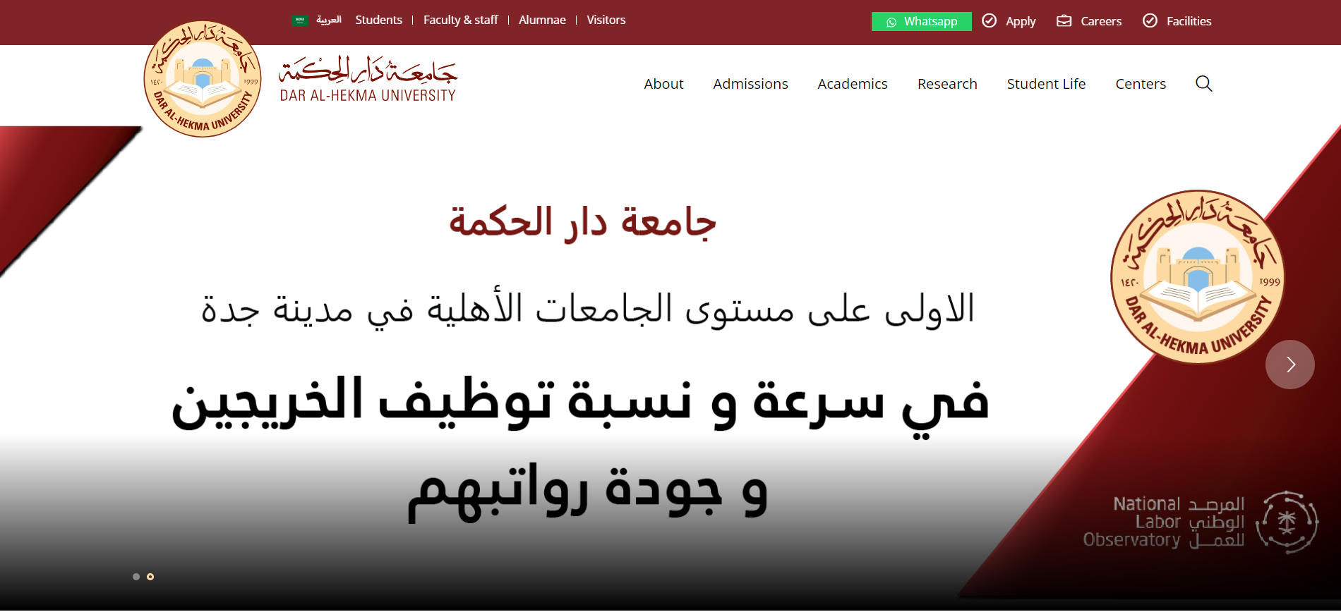
Access Medad System (Library User Portal)
Click here

Slide 4
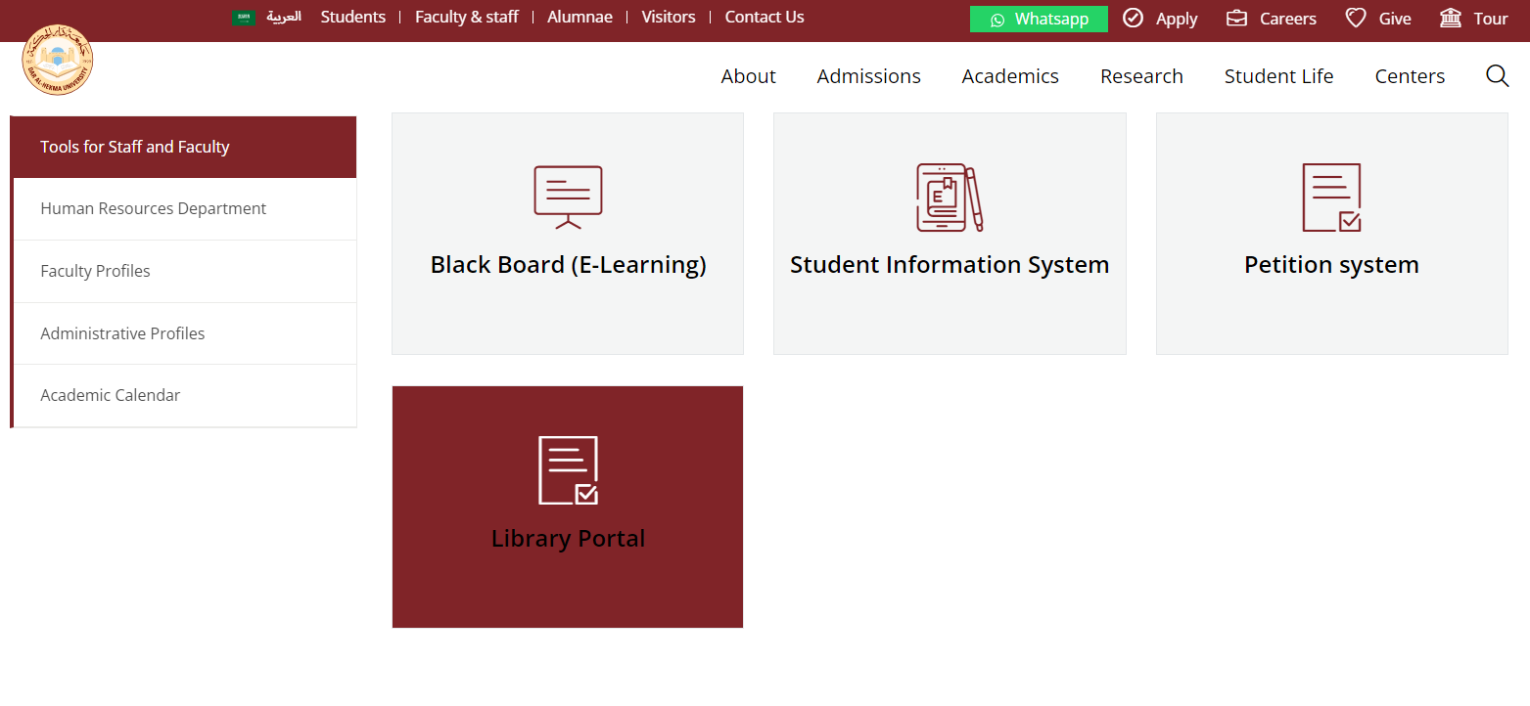
Access the Library User Portal
Click here to access

Slide 5
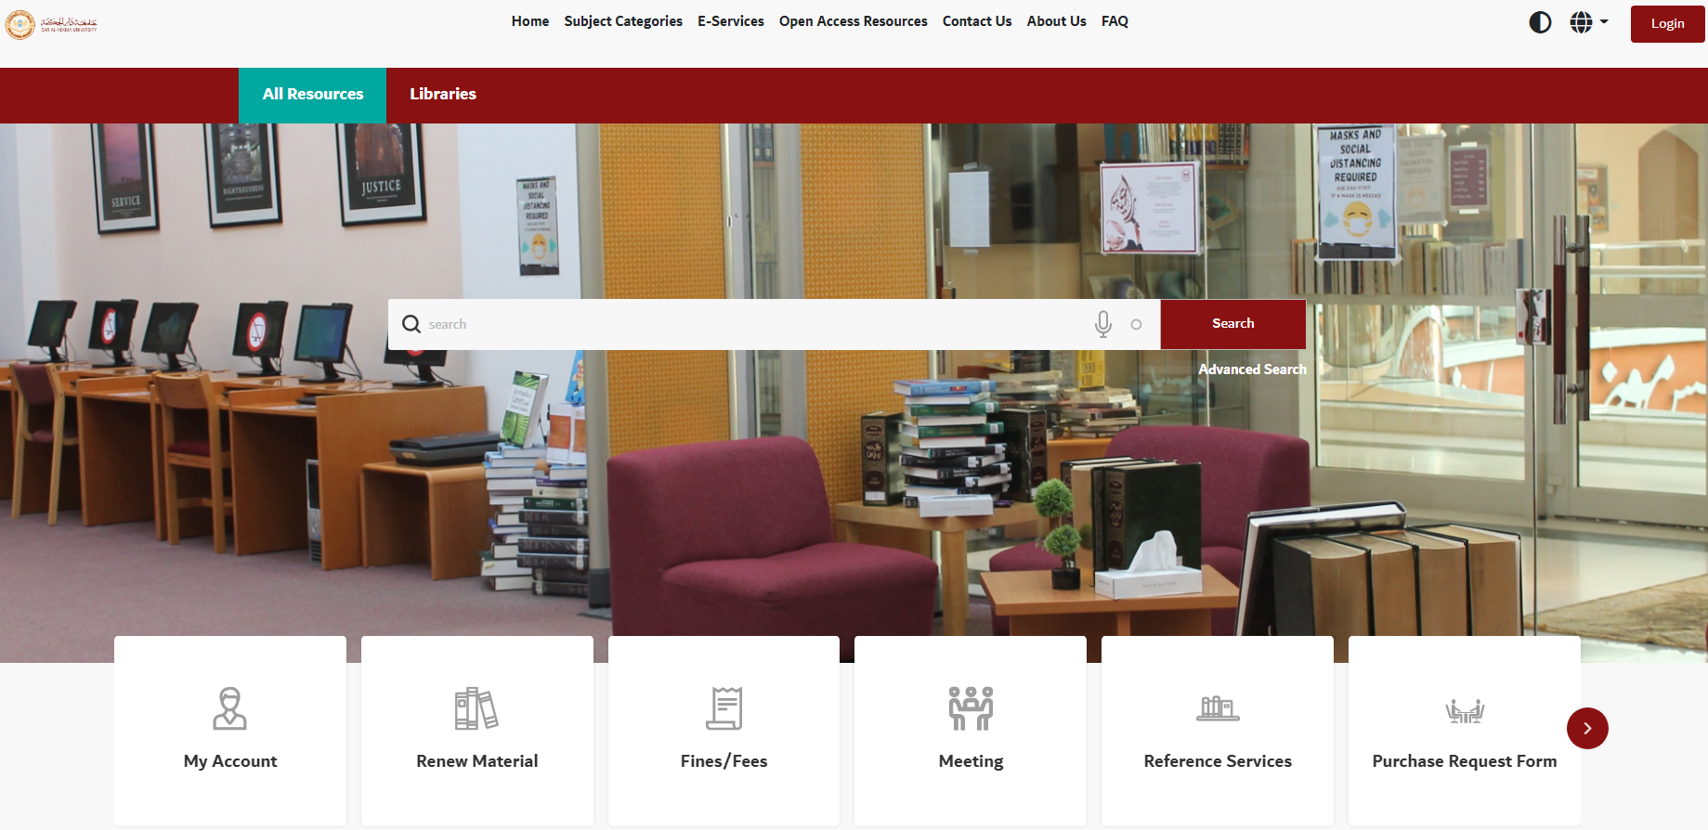
Library Portal Home Page
Click here

Slide 6
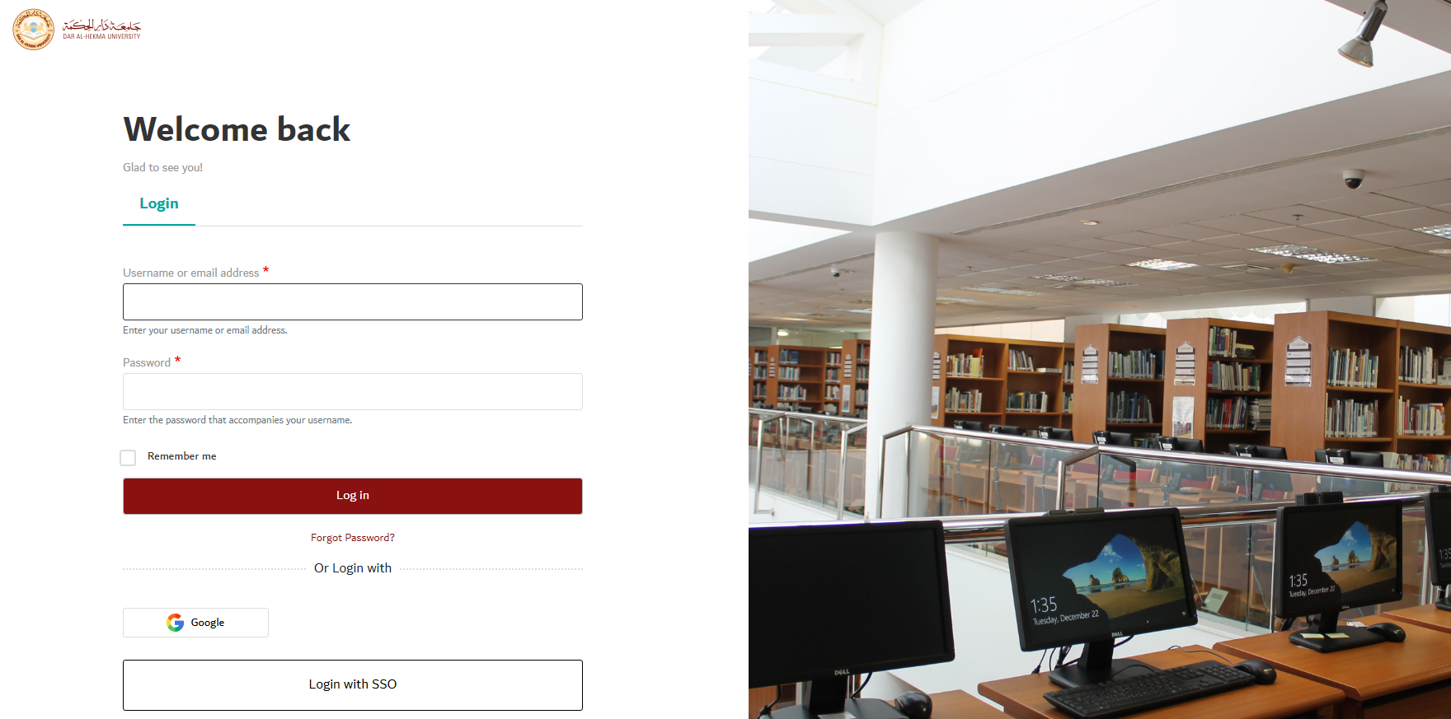
Enter your DAHU Username and Password
Click here to Login

Slide 7
Library Portal Home Page
Click here

Slide 8
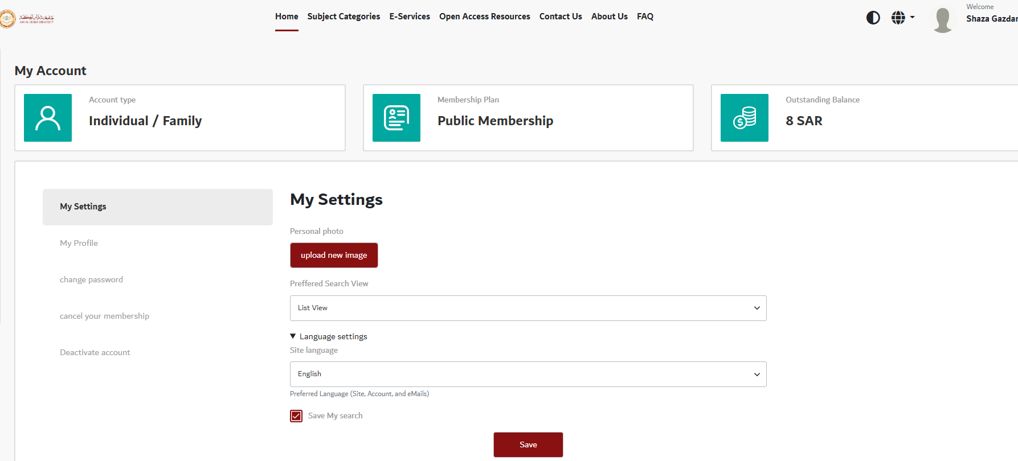
Select “E-Services”
Click here

Slide 9
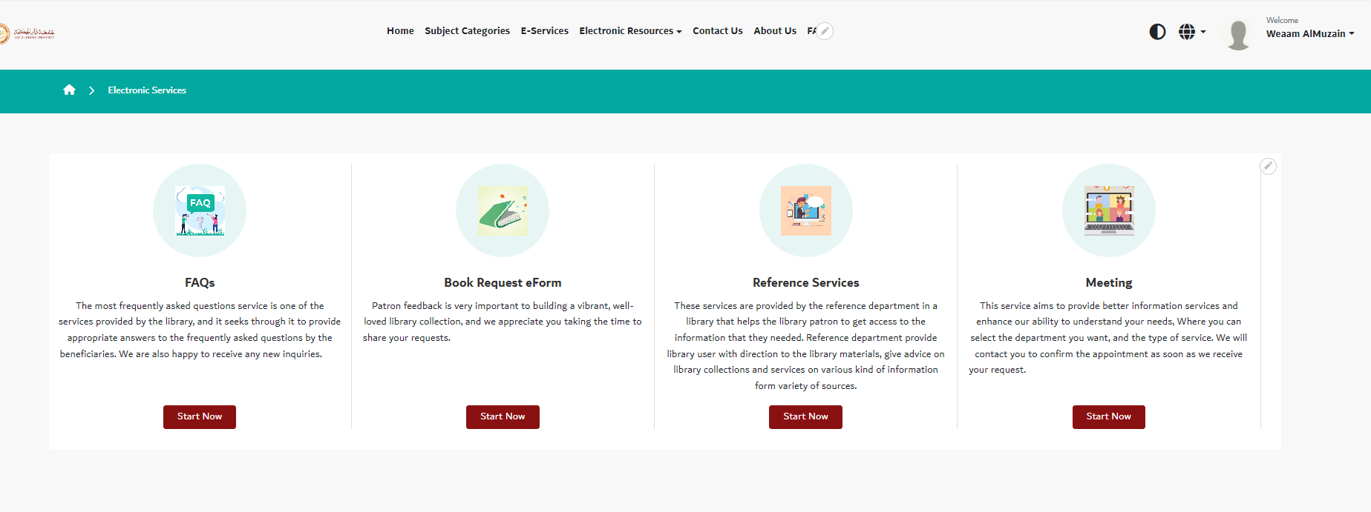
Select “Purchase Request Form”
Click here

Slide 10
Fill out the form
Click here

Slide 11
Library Contact
Please do not hesitate to contact us for further information or assistance.
Visit us: @Main Library -Information Desk
Call us: 630-3333 ext. 167,621, 250, 157.
Send your inquiry via e-mail: library@dah.edu.sa
For more information visit DAHU library web page: https://www.dah.edu.sa/en/research/library/Pages/About-the-library.aspx
We're always happy to hear your feedback on our services, and we welcome suggestions for improvement.

Slide 12
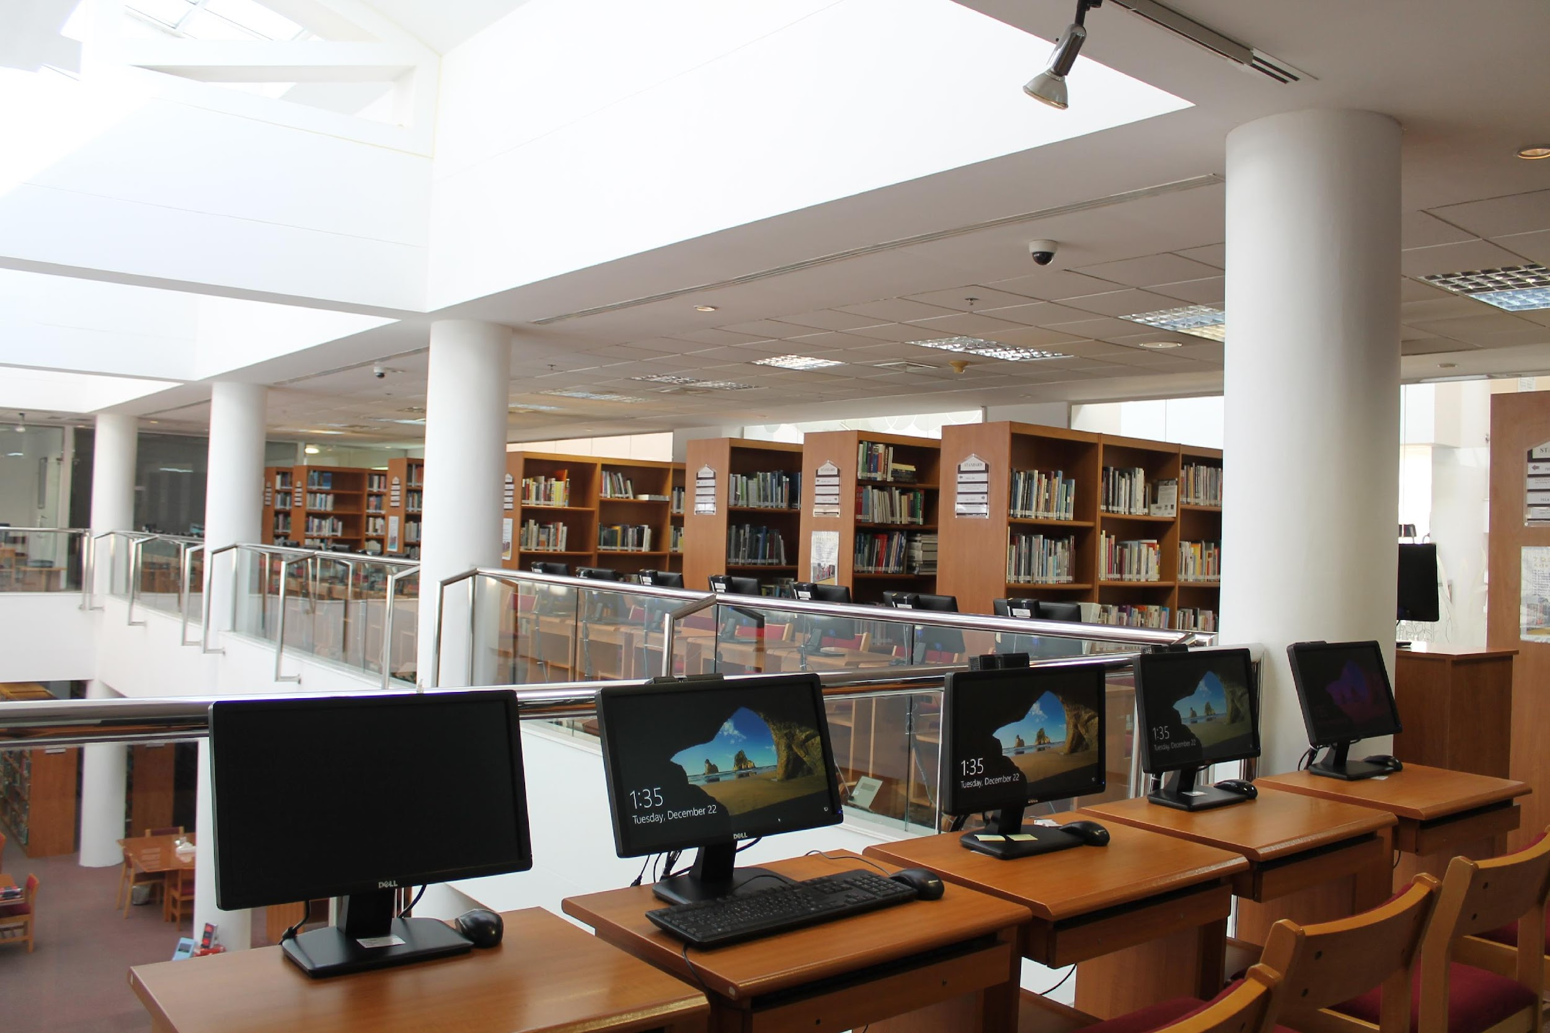
Thank you

