Slide 1
How to Access DAH Library Thesis and Dissertation
Dar Al Hekma University Library

Slide 2
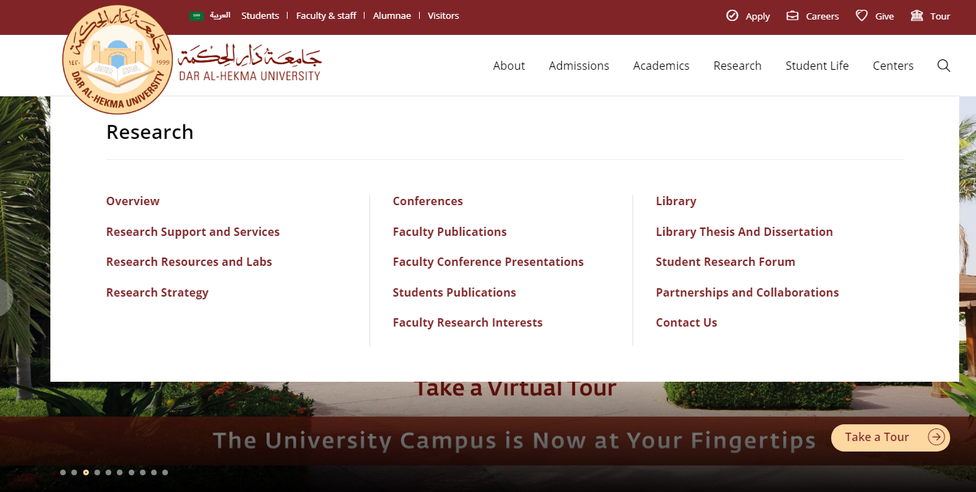
How to Access DAH Library Thesis
Click Here

Slide 3
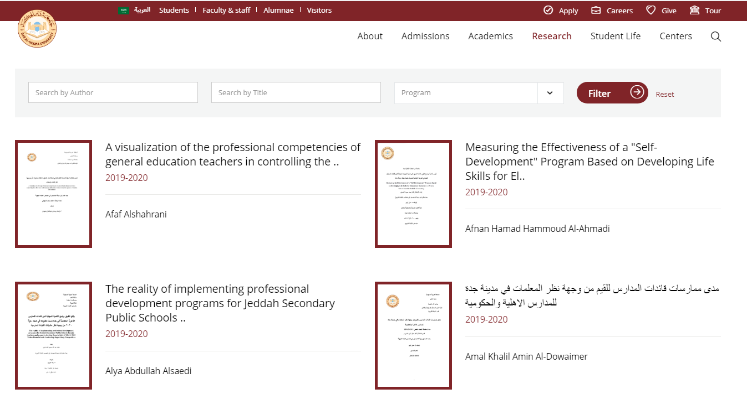
DAH Library Thesis & Dissertation Page
Search by Author
Search by title
Select program
To read the Abstract click on the title or click on the cover page

Slide 4
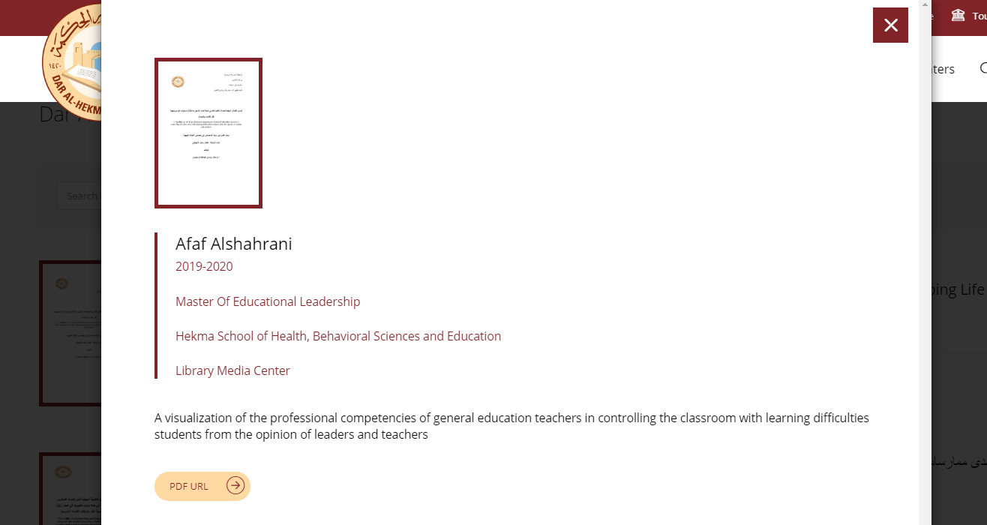
Thesis Abstract
Click Here

Slide 5
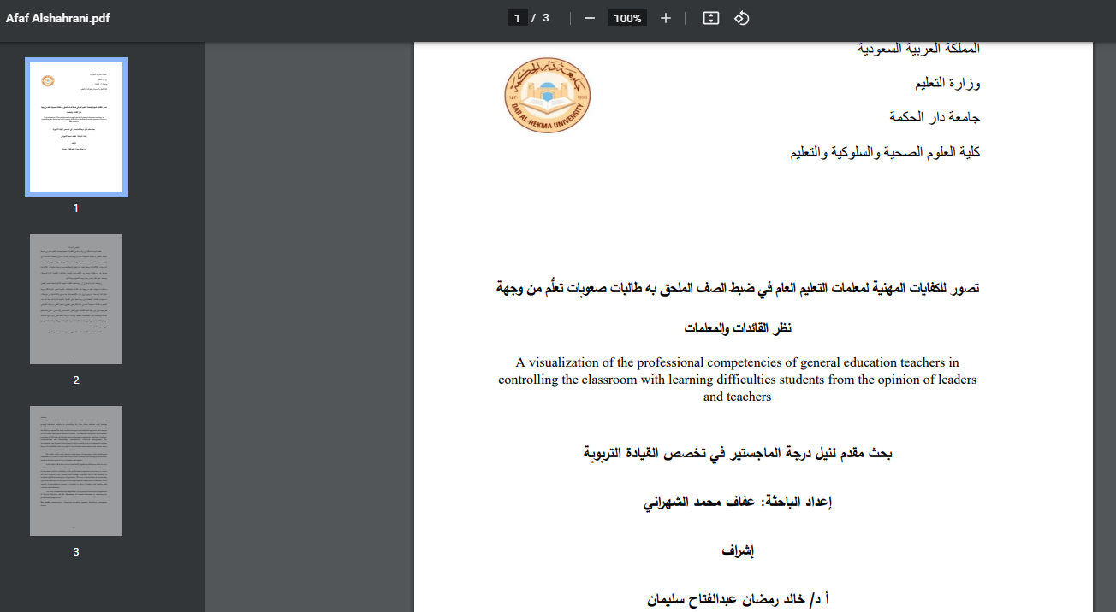
Title Page

Slide 6
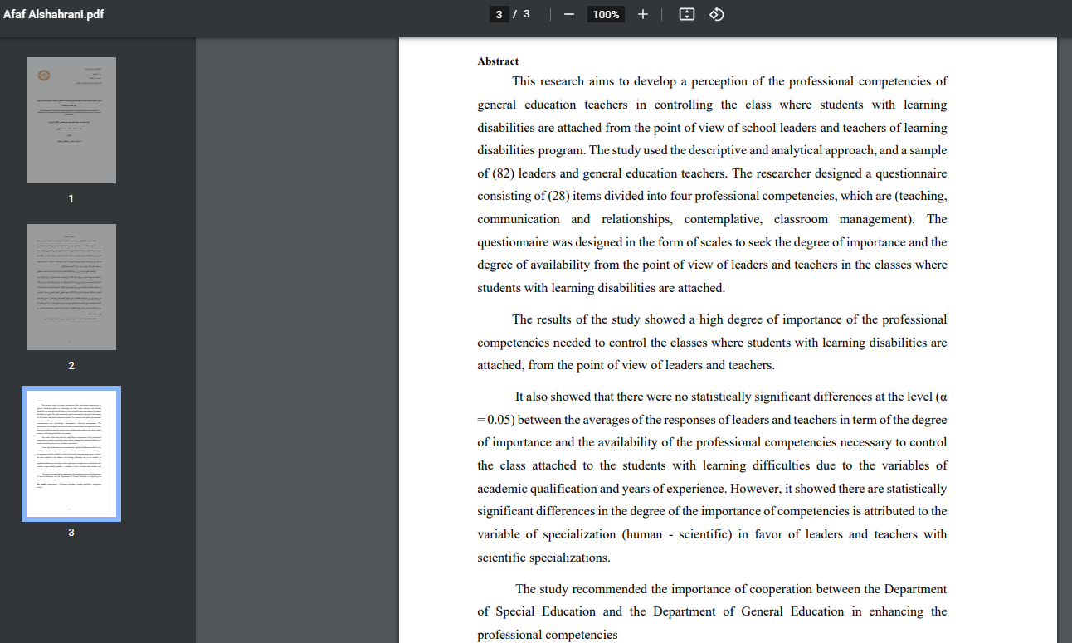
Thesis Abstract

Slide 7
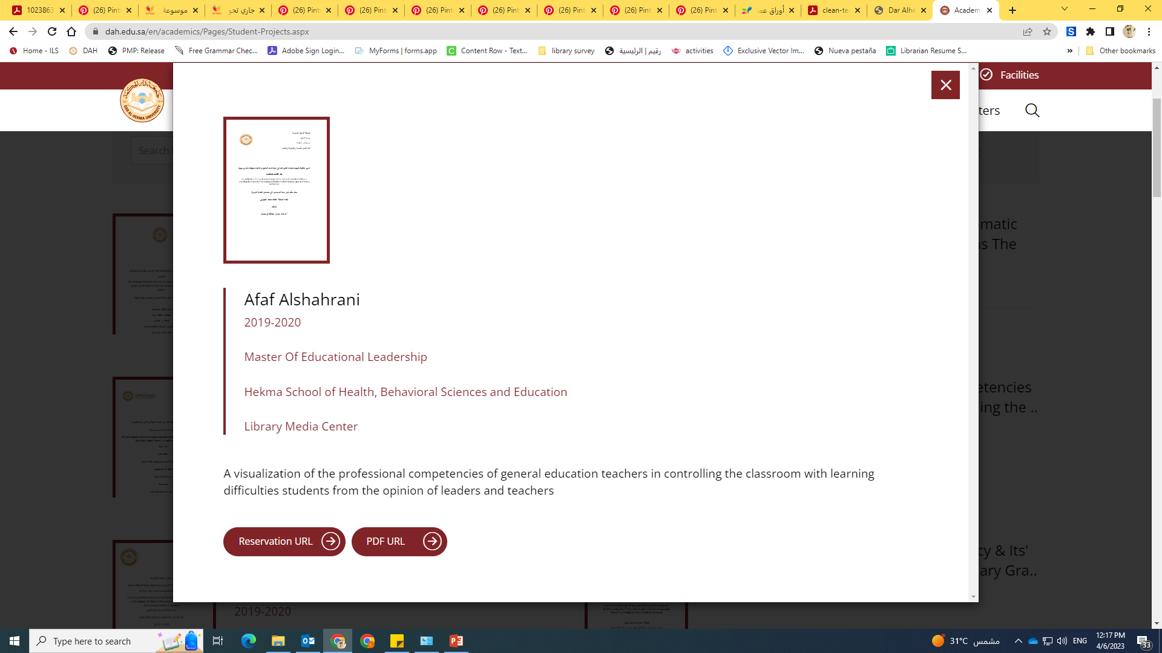
Thesis Reservation
Click Here

Slide 8
Thesis Reservation Fill the Form

Slide 9
Please feel free to contact library if you need any further information
library@dah.edu.sa
librarystaff@dah.edu.sa

